Slide 1


Department of Computer Sciences
AQI Predictor
AI Based App that predict
AQL just By taking photo
Machine Perception and Visual Intelligence Research Group

Slide 2




Our Team Style
WAQAS AHMAD
Ali Hassan
Hamza Sadiq
Dr. Usama Ijaiz Bajwa
Group Leader
Group Member
Group Member
Supervisor
AI Enthusiast
Seeking Career in ML ,Computer Vision and Flutter Developer
You can simply impress your audience and add a unique zing.
You can simply impress your audience and add a unique zing.
Assistant Professor & Associate HOD of Computer Science,

Slide 3
Agenda
INTRODUCTION
PROCEDURE
CONSTRAINTS
OOUTPUT
WORK FORWARD
An intro to the concept of our project
Flow of Entire Application
Limitations of our Project
Interfaces and Result of Our Project
Work we are Doing
1
3
5
7
9
2
4
6
8
PROBLEM
FEATURES
CHALLENGES
TOOLS & TECHNOLGIES
The problem that caused this solution to be created
Positive Aspects of our Application
Challenges We Faced during Development
We used in whole projects

Slide 4
Introduction
An Intro to the Concept Of Our Project

Slide 5

Things to know before start
AQI brief introduction
PM2.5 vitality in perspective of AQI
Categorization of PM2.5

Slide 6
PM2.5 Categorization
PM 2.5 is the particle that have diameter less than 2.5 and possess some value
Particulate matter is the sum of all solid and liquid particles suspended in air many of which are hazardous.
Major cause of Air pollution and causes respiratory problems

Slide 7
Advanced Approaches
Concept to build a system that predict AQL
Android and web based application
Using Deep Learning techniques:
Predict air quality level of any picture.

Slide 8
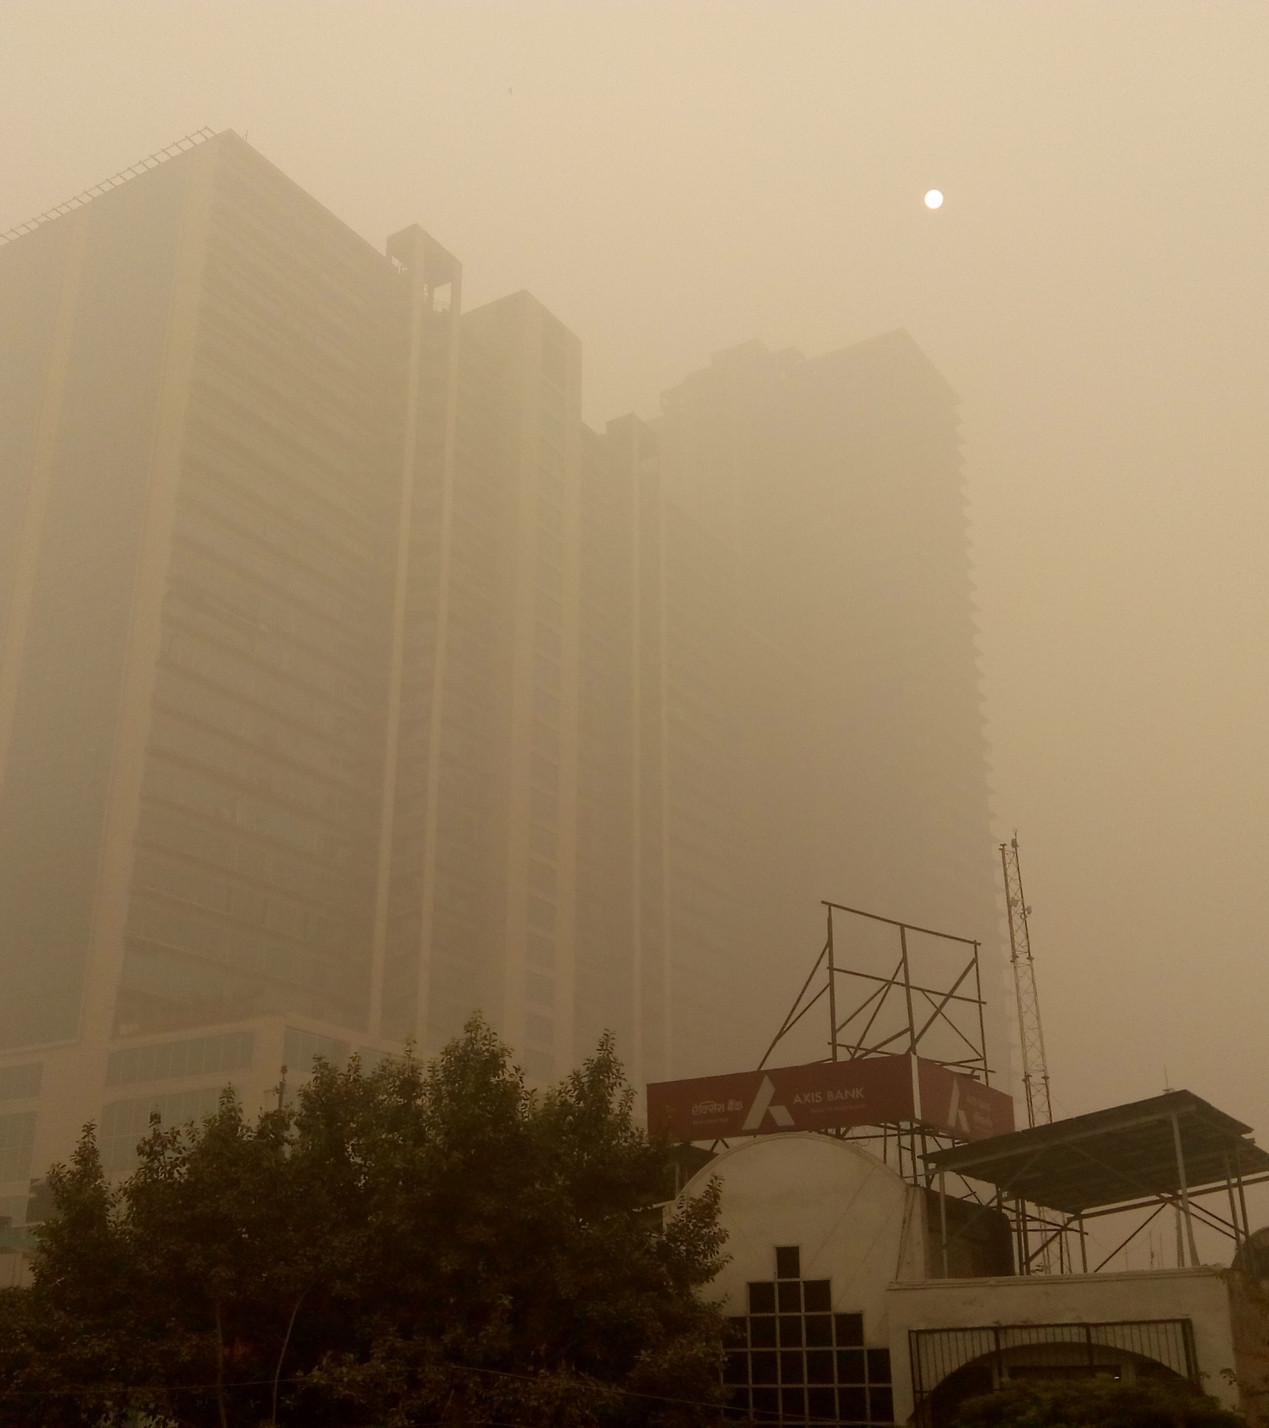
Problems
Problems that Caused this Solution To Be Created
Increasing Ratio Of Chronic Respiratory Diseases
> 3 Millions People Die each Year From chronic obstructive pulmonary disease.
Pakistan Worst AQI Rank
2/ 98 countries ranked in 2019
Expensive Senor
Price of good Sensor is approx. 1 Million
Sensor Range
Range of Good Sensor is approx. 3-3.5KM

Slide 9
Smart Solution
Our Android and Web Application
Use Smart Phone’s Camera to know that Quality of Air in which you Breath

Slide 10
Procedure
Turn On App
Turn On Internet
Getting Location
Display Result
Turn On GPS
Capture Image
Saving Result

Slide 11
Features
Unique App
01
No exact application is available in Pakistan yet.
Cheap Solution to Know Polluted Areas
03
This application’s database will be the largest visual collection of marked polluted areas in Pakistan.
Help in Reducing Air Pollution
02
Application can be used by PMD to spend less time finding the polluted areas and more time to control pollution.

Slide 12
Constraints
GPS Support
User’s Android Device must Support GPS.
Android Version
User needs android device with a working camera and android Version is 6.0 or above.
Active Internet
User Should have active Internet Connection.

Slide 13
Challenges
Challenges we Faced during Development

Slide 14
Challenges
Dataset
01
Dataset Collection & Annotation
Approach
02
Selection Of Technique
Deployment
Porting To Android App
03

Slide 15
Dataset
Dataset that was either of Pakistan or was near to Pakistan in terms of atmosphere and climate.
We couldn’t find any Dataset Of Pakistan.
We opted to use dataset of China that we were able to find.

Slide 16
Dataset Labelling
Data annotation is the task of labelling any type of data : images, audio, text, video, …
We will do it manually.

Slide 17
Selection Of Technique
Either Machine Learning Models or Deep Learning Techniques
Extract features from Images or Feed Image Directly
Regression vs VGG16
VGG16+LSTM or VGG16+Random Forest

Slide 18
Why we Select VGG16
Extracts prominent features from the image automatically.
VGG16 is priorly trained on ImageNet dataset which makes it prone for the classification task
This architecture is flexible and works well on the image Dataset

Slide 19
Deployment In Android
Convert Keras Model to TensorFlow and embed model into android
OR
Use Flask as backend

Slide 20
Using panoptic segmentation
Panoptic Segmentation model (from Detectron2 by Facebook) was chosen to detect sky in the pictures. It’s an incredibly intelligent CNN model that can be used to classify both instance segmentation objects and semantic segmentation objects.
We are using it with customized output to check if there is the sky in the picture or not. Having sky in the picture is our requirement to predict AQ level.

Slide 21

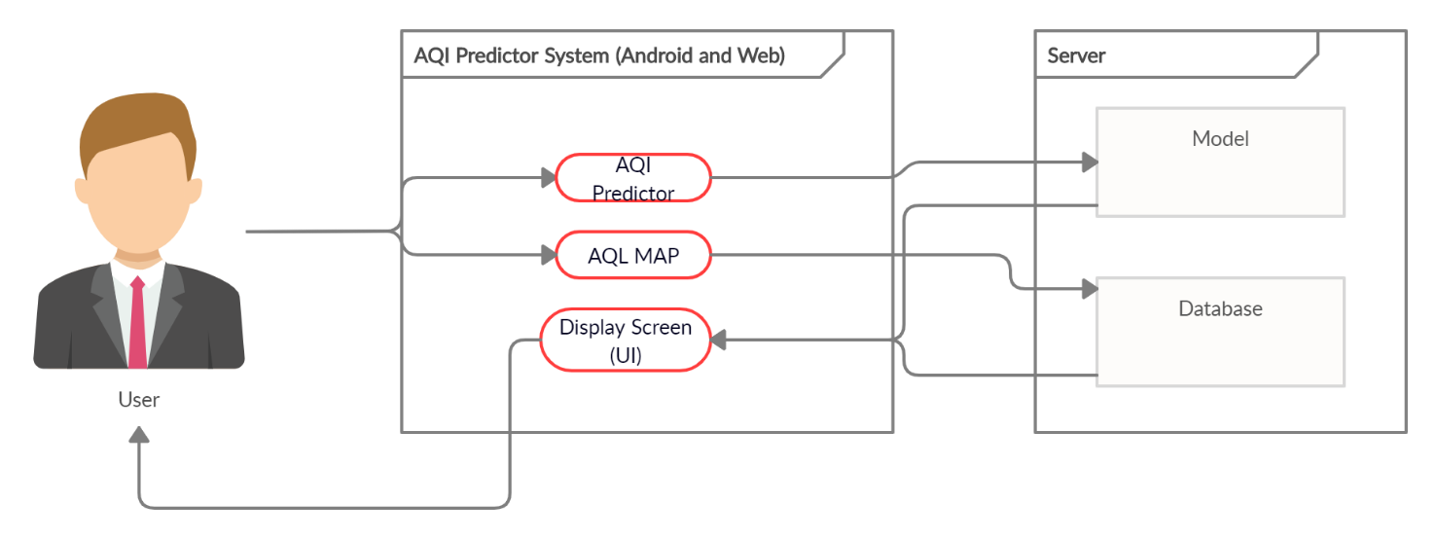
System Architecture
Three-tier architecture
Implementation
Two models used
1st for identifying if sky exists in the picture
2nd for identifying AQL: Our main model
A backend server on which the models are placed and operate on
A database on which data store and retrieve

Slide 22
Output
Interface and Result of our Project

Slide 23
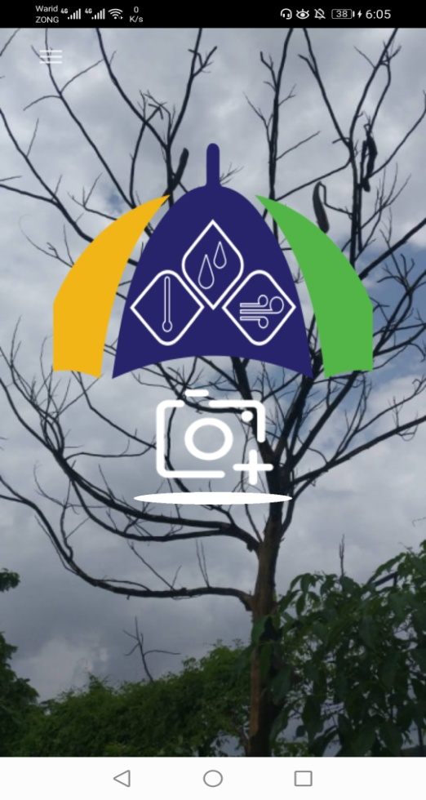
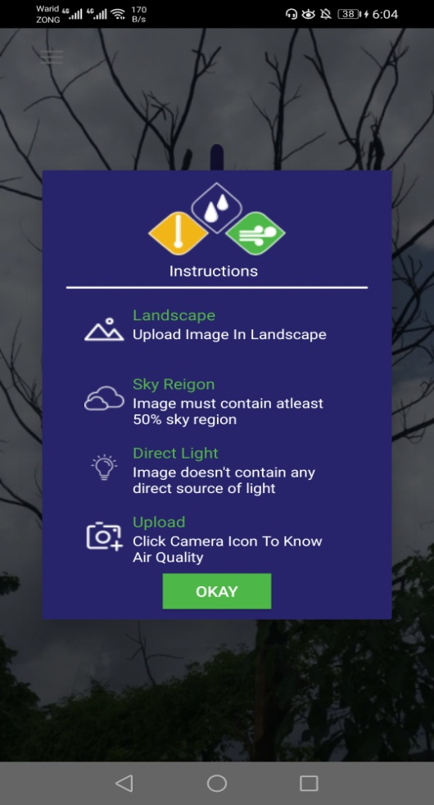
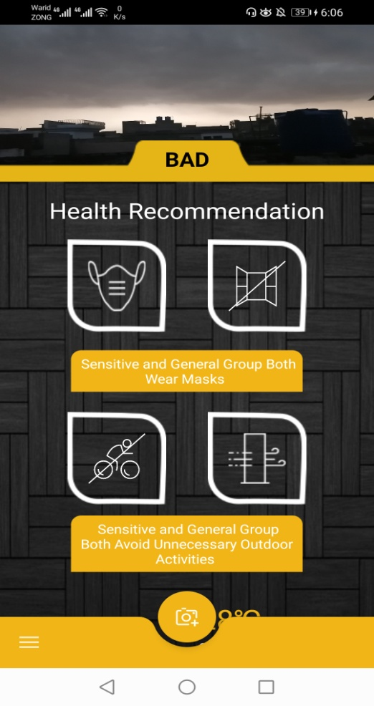
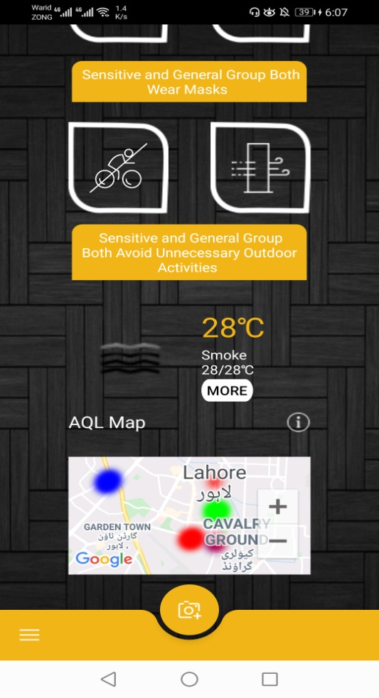
Android App Interfaces

Slide 24
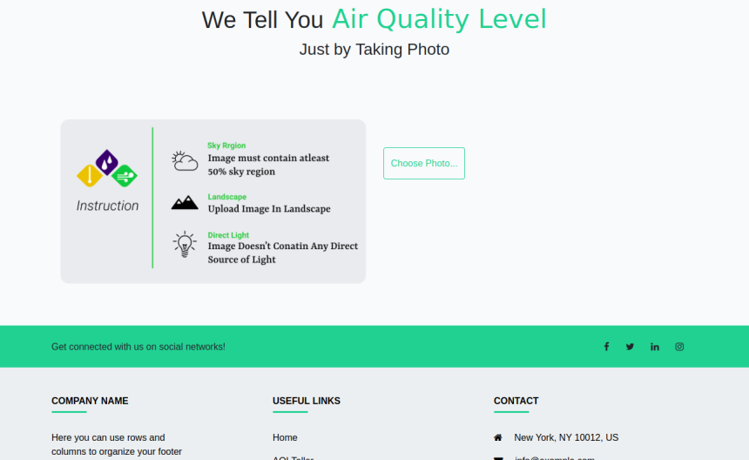
AQI TELLER Interface
In this User Upload Pic and Application tells Air Quality Level
By Clicking Upload User will Upload Image and System check that it is according to instructions or not
Display Result after Processing and Precautions according to Image’s Result.

Slide 25
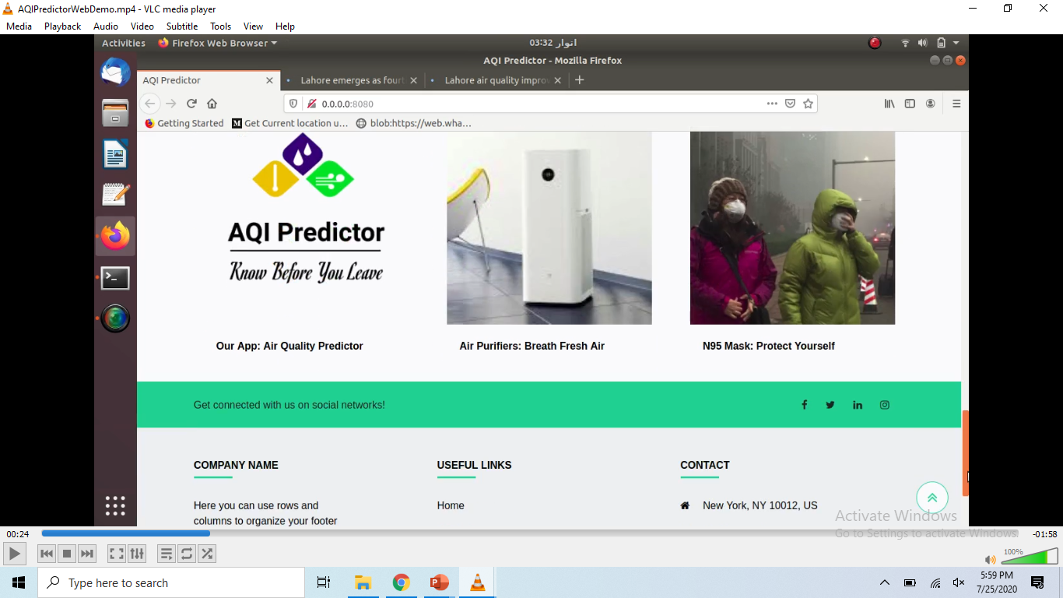
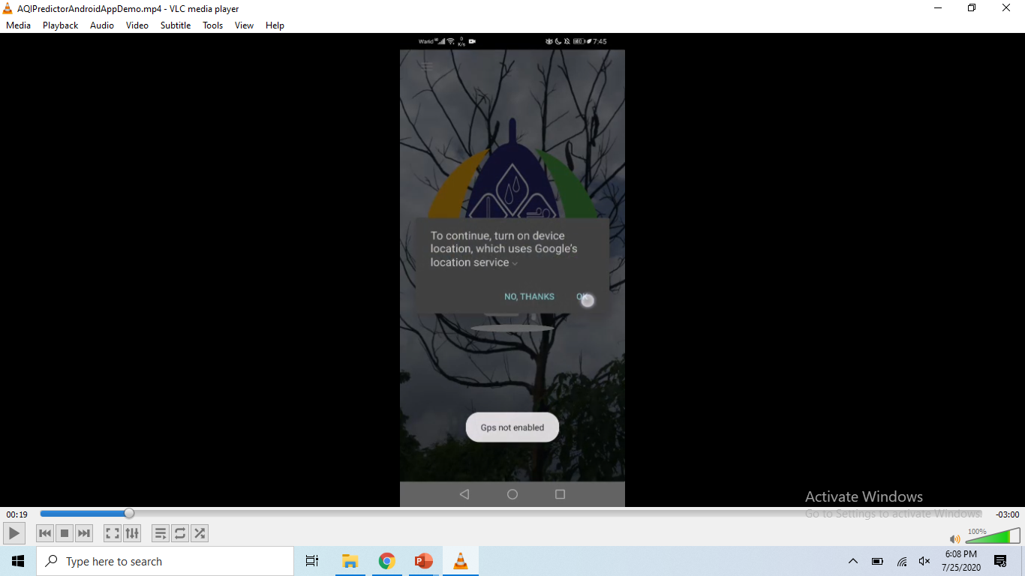
Web App Demo
Android App Demo
01
02

Slide 26










Tools and Technologies

Slide 27


Connect Us Via…
MPVIR
GitHub
Our Work is cited at Machine Perception & Visual Intelligence Research Group
https://sites.google.com/view/mpvir/
Find our Work at GitHub
https://github.com/waqas2727

Slide 28
Future Work
Can be improved to extend usage to pictures without sky and without enough light
Can be improved to calculate AQI
Can further increase accuracy if a more appropriate dataset can be obtained

Slide 29




Additional Working…
Writing a Journal Research Paper.
Team AQI Predictor Collaborating
with PMD Pakistan.

Slide 30
Acknowledgment
We Would Like to Thank:
Allah Almighty who gave us the power and the courage to compete this project
Dr. Usama Ijaz Bajwa (Project Supervisor) for his guidance, which help us to complete this project.
And All Others who Help Us to complete this Project.

Slide 31
JAZAKALLAH
Any Question?

Slide 32
Further Read
For Explanation Purposes

Slide 33
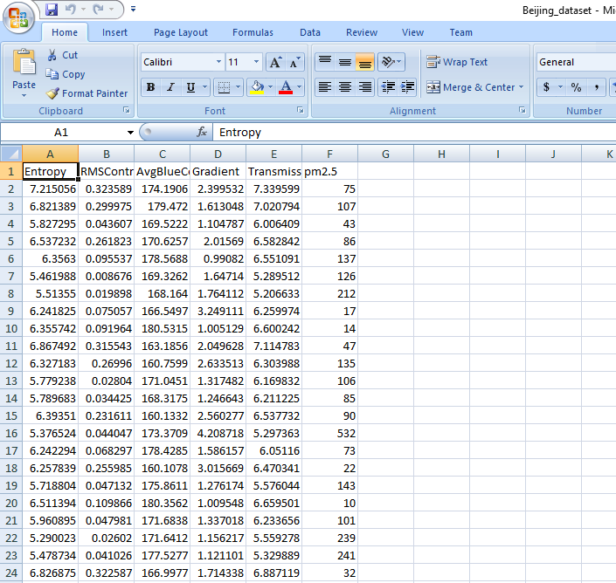
Regression csv file
CSV file screenshot is here with features
Back

Slide 34
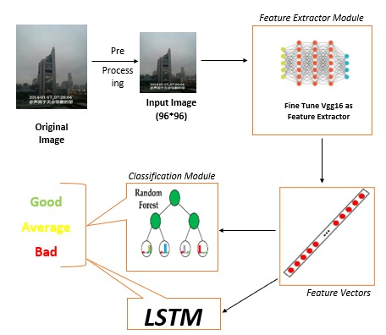
FLOW CHART
Back

Slide 35
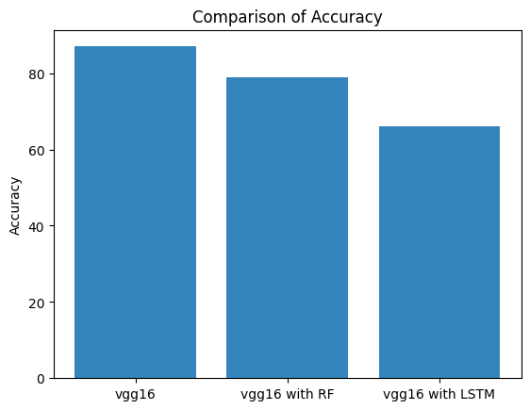
Results
Model | Accuracy(%)
VGG16 | 87.03
VGG16 + LSTM | 66
VGG16 + Random Forest | 79
Back

